Slide 1
Vector Space

Slide 2
zainalat@upm.edu.my

Slide 3
Vector Space
Consider a nonempty set V of vectors where each vector has the same number of components.
If, for any two vectors a and b in V, we have that all their linear combinations αa + βb (α, β any real numbers) are also elements of V.
Furthermore, a, b and c satisfy
A + B = B + A
(A + B) + C = A + (B + C)
A + 0 = A
A + (-A) = 0
Then V is a vector space

Slide 4
Example of a vector space
V
a ∈ V
a is an element of V

Slide 5
Elements abide by the properties of vectors
V
a + b = b + a
c(a + b) = ca + cb
(a + b) + c = a + (b + c)
(c+ d) a= ca + da
a + 0 = a
cd(a) = c(da)
a + (-a) = 0
1a = a

Slide 6
V
V is a collection of elements that can be:
Added together in any combination
Multiplied by scalars in any combination

Slide 7
V
Closure:
Given a∈V and scalar c, then ca ∈V
Given a∈V and b∈V, then a + b ∈V
These determine if V is a vector space

Slide 8
ax + b
set of linear polynomials
c(ax + b) = (ca)x + (bc)
Given a∈V and scalar c, then ca ∈V
Given a∈V and b∈V, then a + b ∈V

Slide 9
ax + b
set of linear polynomials
(a₁x + b₁) + (a₂x + b₂)
(a₁ + a₂)x + (b₁ + b₂)
Given a∈V and scalar c, then ca ∈V
Given a∈V and b∈V, then a + b ∈V

Slide 10
ax + b
This set is a vector space
Given a∈V and scalar c, then ca ∈V √
Given a∈V and b∈V, then a + b ∈V √

Slide 11
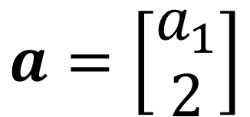
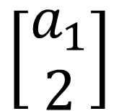
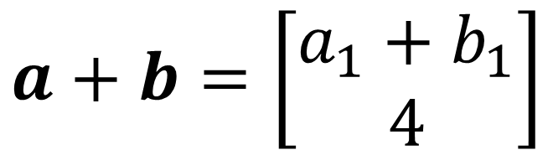
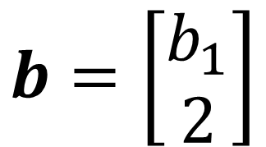
$$\left[\begin{matrix}a_{1} \\ 2\end{matrix}\right]$$
set of vectors of matrix 2 x 1 with 2 in the second row
$$a=\left[\begin{matrix}a_{1} \\ 2\end{matrix}\right]$$
$$b=\left[\begin{matrix}b_{1} \\ 2\end{matrix}\right]$$
$$a+b=\left[\begin{matrix}a_{1}+b_{1} \\ 4\end{matrix}\right]$$
Given a∈V and scalar c, then ca ∈V
Given a∈V and b∈V, then a + b ∈V X

Slide 12
$$\left[\begin{matrix}a_{1} \\ 2\end{matrix}\right]$$
This set is NOT a vector space
$$a=\left[\begin{matrix}a_{1} \\ 2\end{matrix}\right]$$
$$b=\left[\begin{matrix}b_{1} \\ 2\end{matrix}\right]$$
$$a+b=\left[\begin{matrix}a_{1}+b_{1} \\ 4\end{matrix}\right]$$
Given a∈V and scalar c, then ca ∈V
Given a∈V and b∈V, then a + b ∈V X

Slide 13
Span
V
V₁, V₂,… V_{n} ∈ V
a₁V₁ + a₂V₂ +… a_{n}V_{n} Linear combination
Set of all possible linear combination is called their span

Slide 14
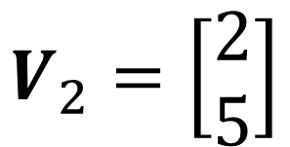
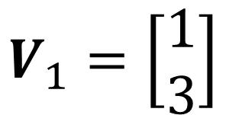
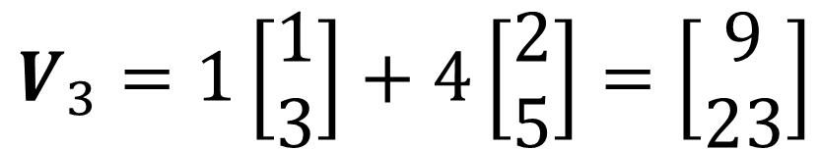
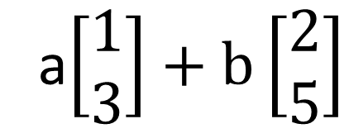
Span
$$V_{1}=\left[\begin{matrix}1 \\ 3\end{matrix}\right]$$
$$V_{2}=\left[\begin{matrix}2 \\ 5\end{matrix}\right]$$
R²
span (V₁, V₂) =
a$\left[\begin{matrix}1 \\ 3\end{matrix}\right]+b\left[\begin{matrix}2 \\ 5\end{matrix}\right]$
Let a = 1, b = 4
Vector V₃ will be in the span of vectors V₁ and V₂
$V_{3}=1\left[\begin{matrix}1 \\ 3\end{matrix}\right]+4\left[\begin{matrix}2 \\ 5\end{matrix}\right]=\left[\begin{matrix}9 \\ 23\end{matrix}\right]$

Slide 15
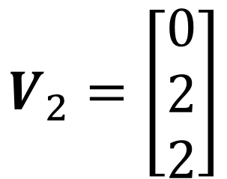
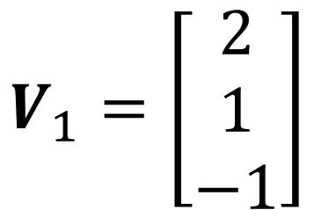
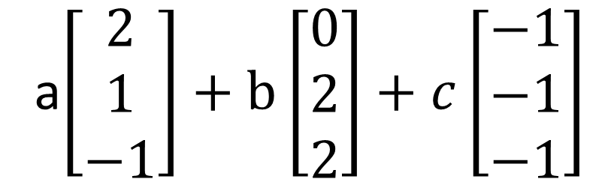
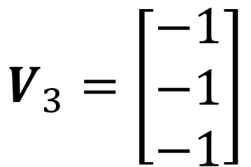
Span
$$V_{1}=\left[\begin{matrix}2 \\ 1 \\ −1\end{matrix}\right]$$
$$V_{2}=\left[\begin{matrix}0 \\ 2 \\ 2\end{matrix}\right]$$
$$V_{3}=\left[\begin{matrix}−1 \\ −1 \\ −1\end{matrix}\right]$$
R³
a$\left[\begin{matrix}2 \\ 1 \\ −1\end{matrix}\right]+\text{b}\left[\begin{matrix}0 \\ 2 \\ 2\end{matrix}\right]+c\left[\begin{matrix}−1 \\ −1 \\ −1\end{matrix}\right]$
span (V₁, V₂,V₃) =

Slide 16
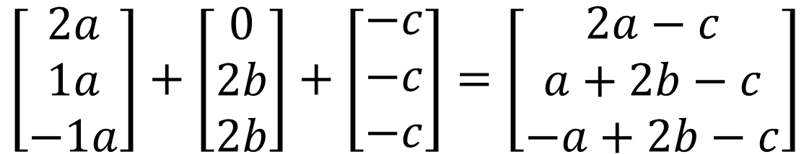
Span
$$V_{1}=\left[\begin{matrix}2 \\ 1 \\ −1\end{matrix}\right]$$
$$V_{2}=\left[\begin{matrix}0 \\ 2 \\ 2\end{matrix}\right]$$
$$V_{3}=\left[\begin{matrix}−1 \\ −1 \\ −1\end{matrix}\right]$$
R³
$$\left[\begin{matrix}2a \\ 1a \\ −1a\end{matrix}\right]+\left[\begin{matrix}0 \\ 2b \\ 2b\end{matrix}\right]+\left[\begin{matrix}−c \\ −c \\ −c\end{matrix}\right]=\left[\begin{matrix}2a−c \\ a+2b−c \\ −a+2b−c\end{matrix}\right]$$
span (V₁, V₂,V₃) =
The span of these three vectors has the form 2a-c, a+2b-c, -a+2b-c

Slide 17
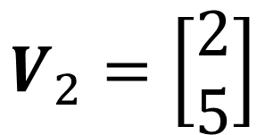
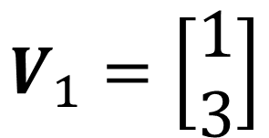
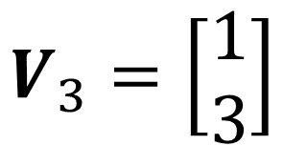
Assignment 4
Show that the vector
$$V_{3}=\left[\begin{matrix}1 \\ 3\end{matrix}\right]$$
belongs to the span (V₁,V₂)
$$V_{1}=\left[\begin{matrix}1 \\ 3\end{matrix}\right]$$
$$V_{2}=\left[\begin{matrix}2 \\ 5\end{matrix}\right]$$

Slide 18
Basis
V
V₁, V₂,… V_{n} ∈ V
A basis is a set of linearly independent vectors that can be used as a building blocks to make any other vectors in the vector space

Slide 19
Basis
V
V₁, V₂,… V_{n} ∈ V
These vectors form a basis for V if:
They are linearly independent
They span the vector space V

Slide 20
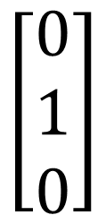



Basis
$$\left[\begin{matrix}1 \\ 0 \\ 0\end{matrix}\right]$$
$$\left[\begin{matrix}0 \\ 1 \\ 0\end{matrix}\right]$$
$$\left[\begin{matrix}0 \\ 0 \\ 1\end{matrix}\right]$$
$$\left[\begin{matrix}a \\ b \\ c\end{matrix}\right]$$
R³
We must check that a linear combination of these vectors can form any vector in the space
They are linearly independent
They span the vector space V

Slide 21
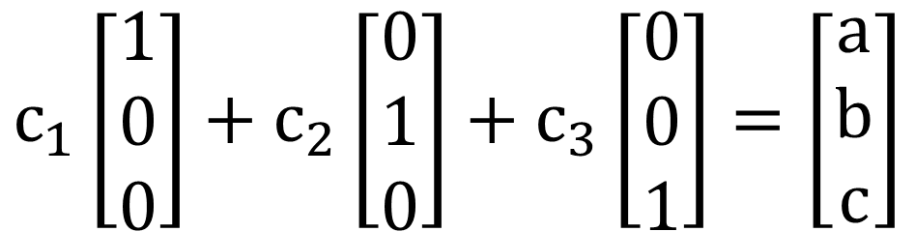
Basis
$$\left[\begin{matrix}1 \\ 0 \\ 0\end{matrix}\right]$$
$$\left[\begin{matrix}0 \\ 1 \\ 0\end{matrix}\right]$$
$$\left[\begin{matrix}0 \\ 0 \\ 1\end{matrix}\right]$$
$$\left[\begin{matrix}a \\ b \\ c\end{matrix}\right]$$
R³
$$c_{1}\left[\begin{matrix}1 \\ 0 \\ 0\end{matrix}\right]+c_{2}\left[\begin{matrix}0 \\ 1 \\ 0\end{matrix}\right]+c_{3}\left[\begin{matrix}0 \\ 0 \\ 1\end{matrix}\right]=\left[\begin{matrix}a \\ b \\ c\end{matrix}\right]$$
c₁, c_{2,} c₃ are variables
a, b, c are numbers
They are linearly independent
They span the vector space V

Slide 22
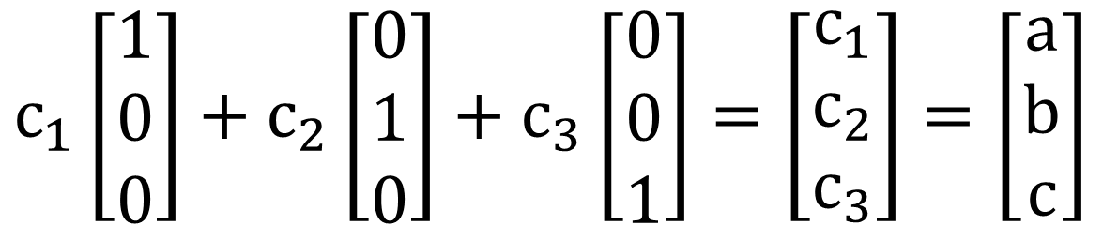
Basis
$$\left[\begin{matrix}1 \\ 0 \\ 0\end{matrix}\right]$$
$$\left[\begin{matrix}0 \\ 1 \\ 0\end{matrix}\right]$$
$$\left[\begin{matrix}0 \\ 0 \\ 1\end{matrix}\right]$$
$$\left[\begin{matrix}a \\ b \\ c\end{matrix}\right]$$
R³
$$c_{1}\left[\begin{matrix}1 \\ 0 \\ 0\end{matrix}\right]+c_{2}\left[\begin{matrix}0 \\ 1 \\ 0\end{matrix}\right]+c_{3}\left[\begin{matrix}0 \\ 0 \\ 1\end{matrix}\right]=\left[\begin{matrix}c_{1} \\ c_{2} \\ c_{3}\end{matrix}\right]=\left[\begin{matrix}a \\ b \\ c\end{matrix}\right]$$
These three vectors span R³

Slide 23
Basis
$$\left[\begin{matrix}1 \\ 0 \\ 0\end{matrix}\right]$$
$$\left[\begin{matrix}0 \\ 1 \\ 0\end{matrix}\right]$$
$$\left[\begin{matrix}0 \\ 0 \\ 1\end{matrix}\right]$$
R³
These vectors form a basis for this vector space
We can build any vector in this space using a linear combination of only these

Slide 24
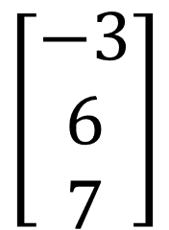
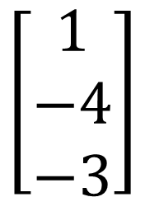
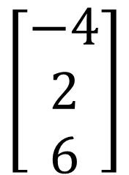
Basis
$$\left[\begin{matrix}1 \\ −4 \\ −3\end{matrix}\right]$$
$$\left[\begin{matrix}−3 \\ 6 \\ 7\end{matrix}\right]$$
$$\left[\begin{matrix}−4 \\ 2 \\ 6\end{matrix}\right]$$
R³
Is this set of vectors a basis of R³?
They are linearly independent
They span the vector space V

Slide 25
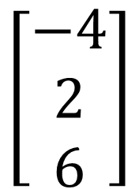
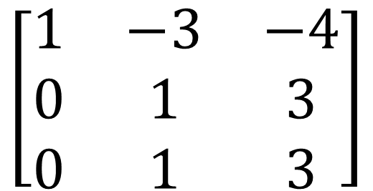
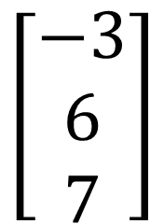
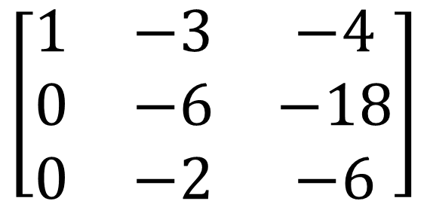
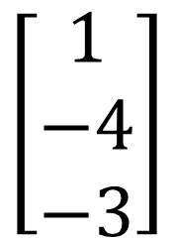
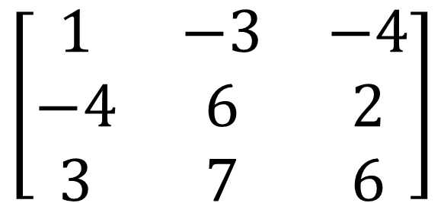
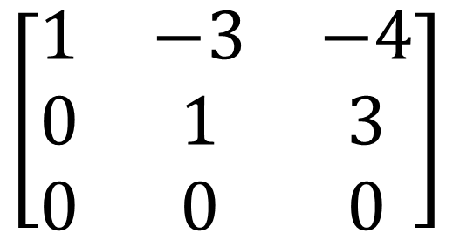
$$\left[\begin{matrix}1 & −3 & −4 \\ −4 & 6 & 2 \\ 3 & 7 & 6\end{matrix}\right]$$
$$\left[\begin{matrix}1 & −3 & −4 \\ 0 & −6 & −18 \\ 0 & −2 & −6\end{matrix}\right]$$
R2=R2+4R1
R3=R3-3R1
$$\left[\begin{matrix}1 & −3 & −4 \\ 0 & 1 & 3 \\ 0 & 0 & 0\end{matrix}\right]$$
$$\left[\begin{matrix}1 & −3 & −4 \\ 0 & 1 & 3 \\ 0 & 1 & 3\end{matrix}\right]$$
$$\left[\begin{matrix}1 \\ −4 \\ −3\end{matrix}\right]$$
$$\left[\begin{matrix}−3 \\ 6 \\ 7\end{matrix}\right]$$
$$\left[\begin{matrix}−4 \\ 2 \\ 6\end{matrix}\right]$$
Is this set of vectors a basis of R³?
NO

Slide 26
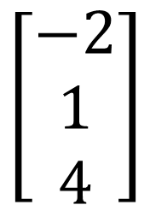

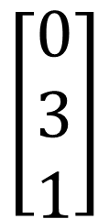
Basis
$$\left[\begin{matrix}1 \\ 0 \\ 1\end{matrix}\right]$$
$$\left[\begin{matrix}−2 \\ 1 \\ 4\end{matrix}\right]$$
$$\left[\begin{matrix}0 \\ 3 \\ 1\end{matrix}\right]$$
R³
Is this set of vectors a basis of R³?
They are linearly independent
They span the vector space V

Slide 27
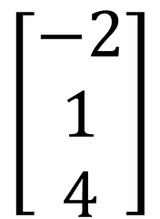
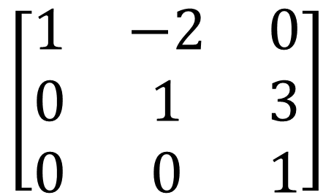
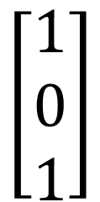
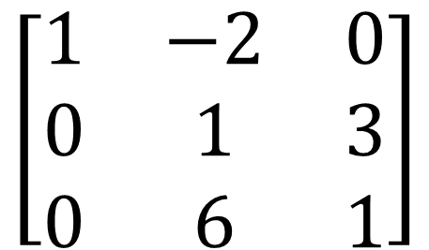
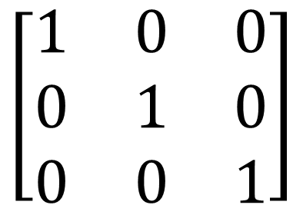
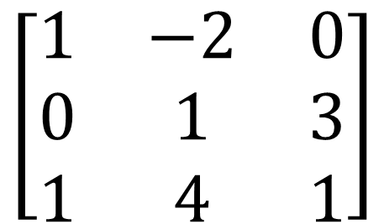
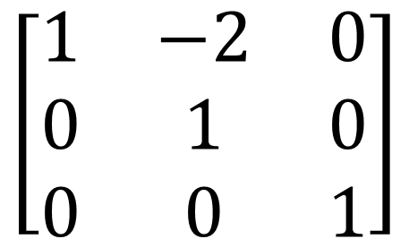
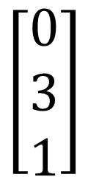
$$\left[\begin{matrix}1 & −2 & 0 \\ 0 & 1 & 3 \\ 1 & 4 & 1\end{matrix}\right]$$
$$\left[\begin{matrix}1 & −2 & 0 \\ 0 & 1 & 3 \\ 0 & 6 & 1\end{matrix}\right]$$
R3=R3-3R1
$$\left[\begin{matrix}1 & 0 & 0 \\ 0 & 1 & 0 \\ 0 & 0 & 1\end{matrix}\right]$$
$$\left[\begin{matrix}1 & −2 & 0 \\ 0 & 1 & 0 \\ 0 & 0 & 1\end{matrix}\right]$$
$$\left[\begin{matrix}1 & −2 & 0 \\ 0 & 1 & 3 \\ 0 & 0 & 1\end{matrix}\right]$$
$$\left[\begin{matrix}1 \\ 0 \\ 1\end{matrix}\right]$$
$$\left[\begin{matrix}−2 \\ 1 \\ 4\end{matrix}\right]$$
$$\left[\begin{matrix}0 \\ 3 \\ 1\end{matrix}\right]$$
Is this set of vectors a basis of R³?
YES

Slide 28
Dimension
The maximum number of linearly independent vectors in V is called the dimension of V and is denoted by dim V.

Slide 29



Dimension
$$\left[\begin{matrix}1 \\ 0 \\ 0\end{matrix}\right]$$
$$\left[\begin{matrix}0 \\ 1 \\ 0\end{matrix}\right]$$
$$\left[\begin{matrix}0 \\ 0 \\ 1\end{matrix}\right]$$
this vector space has dimension 3
The maximum number of linearly independent vectors in V is called the dimension of V and is denoted by dim V.

